Slide 1
Justice Ambassador Training
July 2021
Task-Based Learning, Formerly Incarcerated Cohort

Slide 2
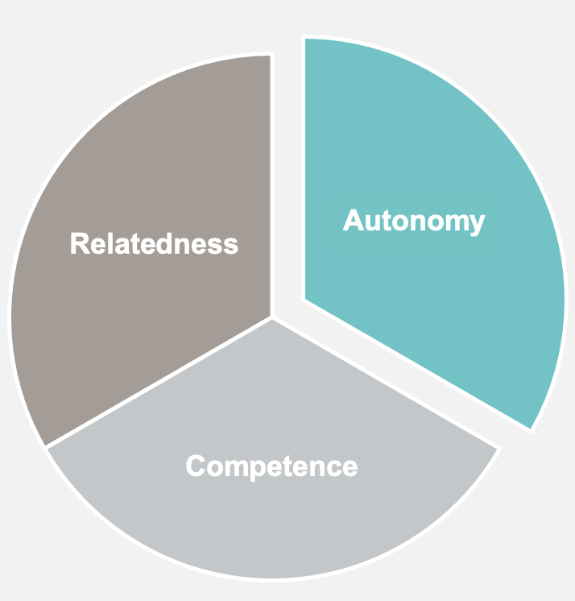
Justice Ambassador Training Purpose
Self-Determination:
Autonomy
Competence
Relatedness
Equipping formerly incarcerated persons to:
Enjoy a “seat at the table”
Advance the legislative agenda
Engage the community
Adhere to brand standards
Powered by Self-Determination
Notes:
Autonomy: create choices, allowing them to act, determine their own direction
Competence: provide structure/guidance fading to independence, timely feedback Relatedness: foster a sense of belonging, connection, and safety

Slide 3
Strategy: Task-Based Learning
Pursue critical advocacy tasks to provide momentum toward other related learning goals
Notes:
Learning Strategy

Slide 4
Leverage Related Goals in Pursuit of Primary Tasks
Justice Ambassador Goals | Justice Ambassador Goals
✓ | Professionalism
✓ | Leadership
✓ | Self-Determination
✓ | Authentic Community
✓ | Communication/Storytelling
✓ | Community Engagement
✓ | Digital Literacy
✓ | Political Acumen
Notes:
Our “Goals” for the Justice Ambassadors (or desired learner outcomes) are, in essence, categories of skills required to reach those goals. We have more discrete learning objectives that will be used in the weekly programming. Here is the more complete wording of the goals (that did not fit on the slide!):
Demonstrate a command of leadership principles
Exhibit professionalism and self-management
Increase self-determination
Cultivate authentic community
Advance advocacy objectives
Effectively communicate through storytelling and other electronic and personal interactions
Leverage community engagement to grow social/political network and grow knowledge for the promotion of advocacy goals
Display political acumen, applying knowledge of policy and politics to the various tasks required
Use specialized toolkits to extend learning to all advocacy tasks

Slide 5
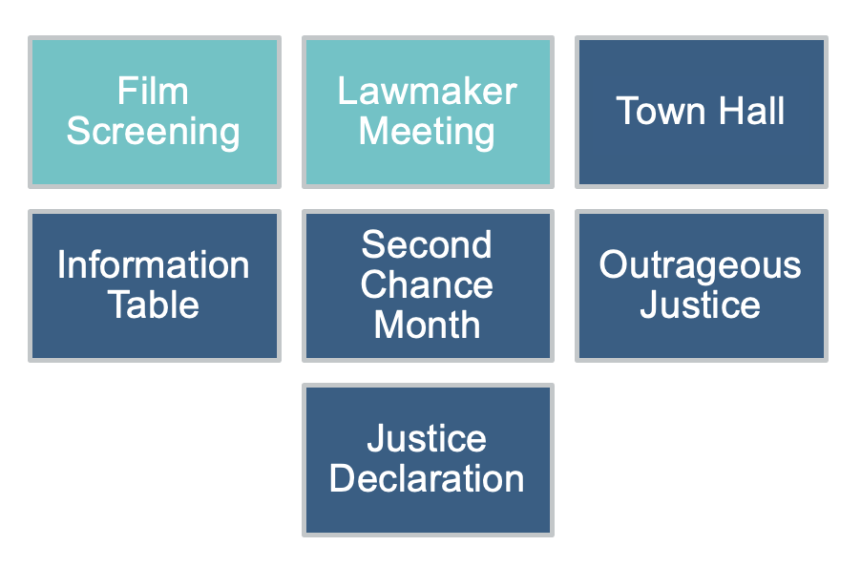
Common Advocacy Tasks
Film Screening
Lawmaker Meeting
Information Table
Town Hall
Second Chance Month
Outrageous Justice
Justice Declaration
PRIMARY TASKS:
Film Screening
Lawmaker Meeting
Notes:
“Advocacy Tasks” represent the major initiatives of the Advocacy Department. Justice Ambassadors must use a common set of skills to approach these varied tasks. By growing these skills, they will be able to move from task to task more easily than if they approach the tasks as completely separate entities. The Film screening and the Lawmaker meeting provide a context for situated learning of the skills and critical behaviors required of JAs. Beyond imparting knowledge, we are developing the individuals to use that knowledge in dynamic and high-stakes settings..

Slide 6
Method: Blended Learning
Social Learning
Scenario-Based Role-Play/Rehearsal
Online Learning (asynchronous & synchronous)
Performance Supports
Notes:
eLearning via curated content (LinkedIn Learning, RightNow Media, PF resources)
Social Learning
Scenario-Based Role-Play/Rehearsal
Performance Supports (checklists, job aids)

Slide 7
Social Learning
Cognitive Apprenticeship, Self-Determination, Community of Practice, Coaching, Peer Learning
Notes:
Learning Strategy

Slide 8
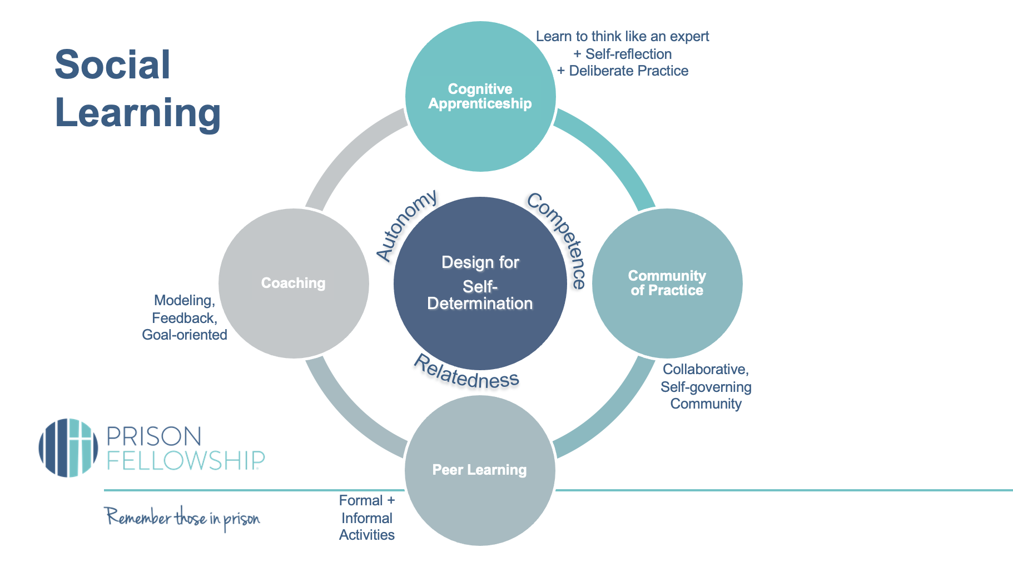
Learn to think like an expert + Self-reflection + Deliberate Practice
Pillars of Self Determination (basic psychological needs, when met, people experience agency, wholeness, intrinsic motivation)
Social
Learning
Community of Practice
Peer Learning
Coaching
Design for
Self-Determination
Cognitive Apprenticeship
Autonomy: People need to feel in control of their own behaviors and goals.
Relatedness
Competence
Autonomy
Competence: People need to gain mastery of tasks and learn different skills.
Relatedness or connection: People need to experience a sense of belonging and attachment to other people.
Modeling,
Feedback,
Goal-oriented
Collaborative,
Self-governing
Community
Formal + Informal Activities
Notes:
GOAL: Self-determination – the basis for intrinsic motivation and self-directed agency (WE CAN DESIGN TRAINING THAT WILL CULTIVATE THE BASIC PSYCHOLOGICAL NEEDS)
Cognitive Apprenticeship looks like scaffolding and support from and expert – intentionally teaching learners to think like experts (giving them the tacit/implicit information)
Community of Practice looks like like-minded members pursuing goal together, resulting in social support, knowledge sharing, and networking
Peer Learning looks like puzzle assignments, knowledge creation, development of better practices (as iron sharpens iron…)
Coaching looks like performance driven, practice with feedback, coaching to expertise

Slide 9
Cognitive Apprenticeship: Learn to Think like an Expert
Modeling
Coaching
Scaffolding
Exploration
Articulation
Reflection
Notes:
Cognitive Apprenticeship = Learning to think like an expert…
Modeling:
Use human expert resources (live or video) to derive model/goals – leverage shadowing opportunities (multiple means)
Experts give “insider tips/knowledge”
Coaching: As learners perform tasks, they enjoy Expert/Peer Guidance
Individualized feedback
Expert observes student demonstrate a skill
Replay of a videotaped student performance
Checklists for trainers and learners
Formative assessments
Scaffolding: carry out tasks with support, Social Learning, collaboration
Individualized support from experts
Conceptual models, algorithms
Hints, reminders, access to resources, informal chatting
Simulations, scenarios
Social Learning, collaboration
Spiritual support
Reflection: Reflect on experience, analyzing one’s performance and thought process. In cognitive apprenticeship, the student is able to compare their ideas with the instructor. Examples:
Post-performance reflection
Informal or formal discussions with colleagues or peers
Portfolios, online forums, journals, online prompts, video footage of performance
Comparison with expert performance
Encouragement by mentors
Articulation: discussing one’s thought process with others. Making thinking visible is a key component of the cognitive apprenticeship framework. Examples:
Summative assessments
Socratic questioning, assessment questions
Students explain rationale
Exploration: (Own and Extend) With increased competence and autonomy, learners are equipped to move toward expertise over time, applying learning to new tasks, developing independence and their own learning goals (where they can [1] reach organizational goals [2] shape organizational policy [3] step into the mentor role for others)

Slide 10
Scenario-Based Role-Play/Rehearsal
Notes:
Learning Strategy

Slide 11
Rehearsal Platform (Learner Experience)
Play the Prompt
Record the Response

Slide 12
Rehearsal Platform (Mentor Experience)
Create learning paths
Review video submissions
Consider AI data
Score response against a rubric
Provide Timeline Based Feedback
Leave comments (written or video)
Promote a response to the leaderboard
Prompt for a new response
Download learner video submissions

Slide 13
Online Learning
Introduce concepts, provide practice opporunities, equip for tasks
Notes:
Learning Strategy

Slide 14
Justice Ambassador Online Learning
eLearning courses in the LMS
Video Training
Webinars
Knowledge Base
Community of Practice

Slide 15
Strategy: Performance Supports
Leverage performance supports to drive the training process and sustain learning
Notes:
Learning Strategy

Slide 16
ADVOCACY PROCESS
Advocacy Request
Practice
Task
Follow Up
Prep with Specialist

Slide 17
ADVOCACY Training PROCESS
Check the course calendar
Pull up the assignment
Access the toolkit
Complete the assignments
Advocacy Request
Guide
Plan
Feedback
Checklist
Practice
Follow Up
Task

Slide 18
Guide + Toolkit Resources > Assignment Documents
+
>

