Slide 1
Storytelling Curriculum
Justice Ambassador Cohort

Slide 2
Justice Ambassador Cohort Format
Online Learning
In-Person Workshop
Cohort Experience
Tools
Notes:
This is replicable and scalable to a 1:1 mentoring (performance w/ feedback)
Asynchronous > in person > virtual > performance supports (for the time of need + for future performance settings)

Slide 3
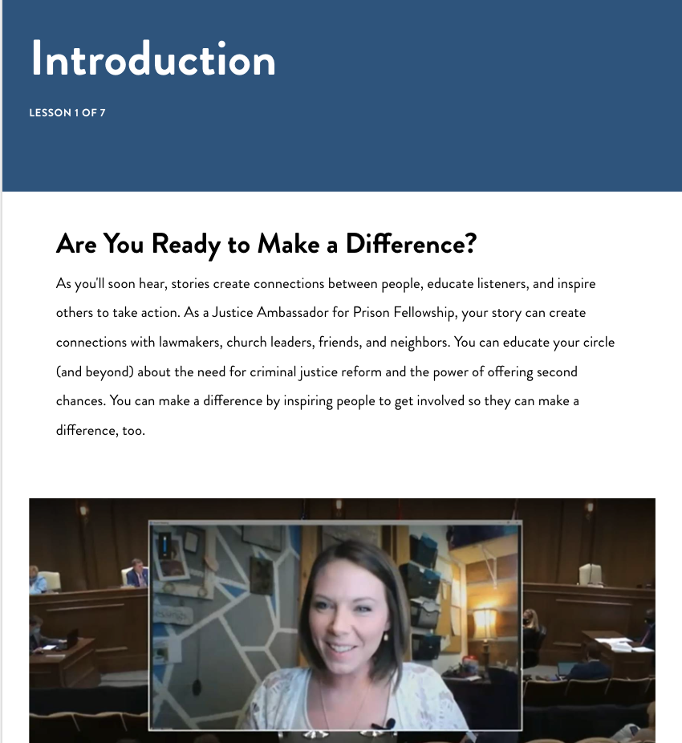
Justice Ambassador Online Learning
Growing Your Mindset
Advocacy Knowledge Training
Language & Tone
Developing Your Story
Notes:
“Growing Your Mindset” (Set standard of embracing practice w/feedback and continuous improvement)
Advocacy knowledge training (Deliver Content/Context-specific knowledge)
Language & Tone (Provide Guidance on Language & Tone; Hello, My Name Is Felon, Justice Ambassador Messaging document)
“Developing Your Story” (Coach learner through building their written story, provide a template and tools for future storytelling, provide worked examples)

Slide 4
Storytelling Course
Notes:
DEVELOPING YOUR STORY >>> Come out of this course with a good rough draft, ready to edit—follow up quickly with feedback, in-person or virtually
Self-paced
Video coaching + written content
Knowledge Checks
Worked Examples
Skill practice
Tools

Slide 5
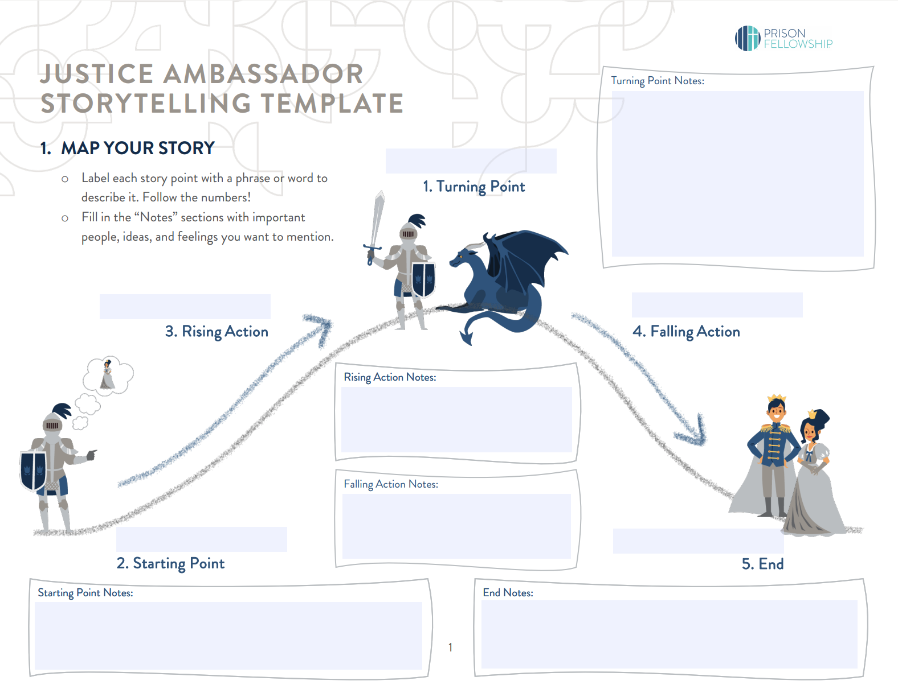
Storytelling Template
Notes:
Fading scaffolding/fading support

Slide 6
In-Person Workshop
Story Editing
Story Presentation
Brand Ambassadorship
Navigating Difficult Conversations
Public Speaking Practice
Feedback & Coaching
Peer Learning
Digital Storytelling
Notes:
Language & Tone (Guidance on Language & Tone; Hello, My Name Is Felon, Justice Ambassador Messaging)
Brand Ambassadorship & Protecting the Non-Profit

Slide 7
Cohort Experience
Zoom meetings
Using your story as a tool
Prepping for and meeting with lawmakers
Advocating for Second Chances
Digital Advocacy
Social Learning
1:1 Coaching
Peer Support
Rehearsal platform
Scenario-based training
Simulated Digital Advocacy
Simulated Lawmaker Meeting
Notes:
WEEKLY ONLINE MEETINGS
Extending the storytelling curriculum/content (generalizing the training to other contexts)
Practice with Feedback
Creating Social Learning opportunities

Slide 8
Rehearsal Platform (Justice Ambassador Curriculum)
Welcome to Rehearsal! (Practice)
Your Full Story
Recruiting a Second Chance Month Partner
Grace Under Pressure in Difficult Discussions
HOT SEAT: What is Prison Fellowship?
Lawmaker Meeting Agenda/Pitch
The 1-Minute Call to Action
Your Final Full Story

Slide 9
Rehearsal Platform (Learner Experience)
Playing the Prompt
Recording the Response

Slide 10
Rehearsal Platform (Mentor Experience)
Create learning paths
Review video submissions
Consider AI data
Score response against a rubric
Provide Timeline Based Feedback
Leave comments (written or video)
Promote a response to the leaderboard
Prompt for a new response
Download learner video submissions

Slide 11
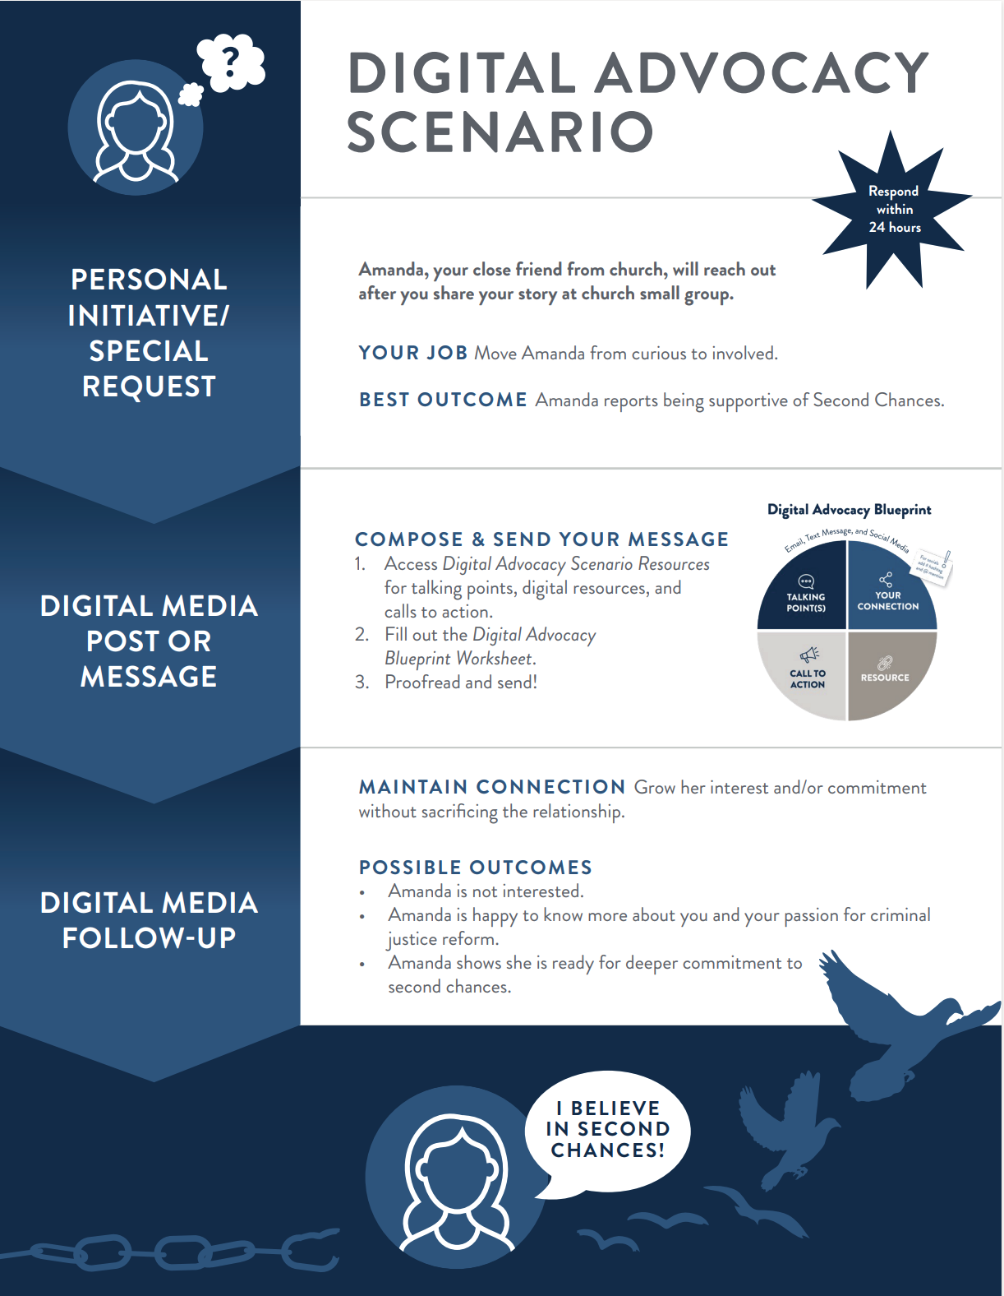
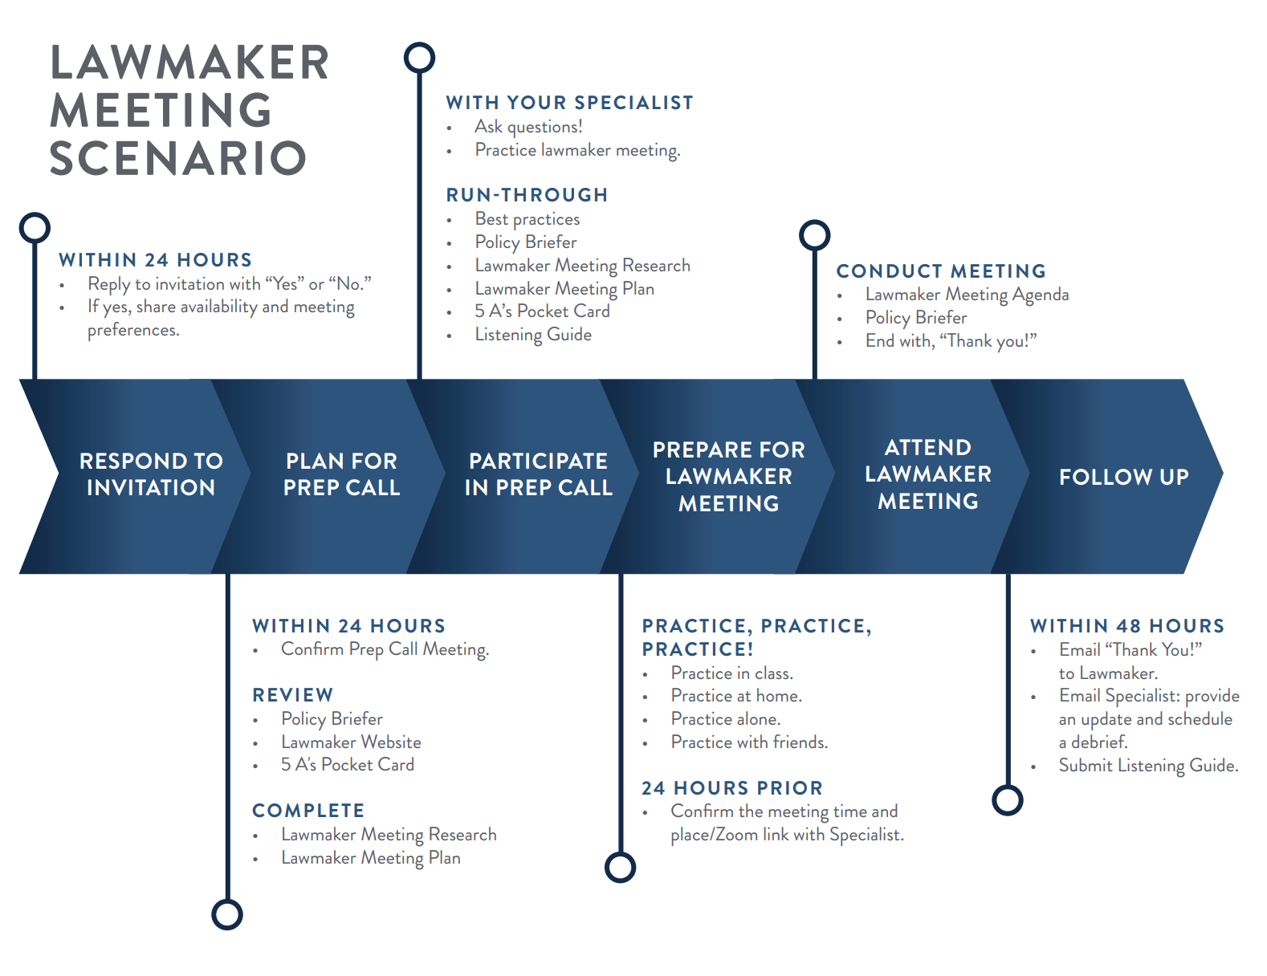
Scenario-Based Training

Slide 12
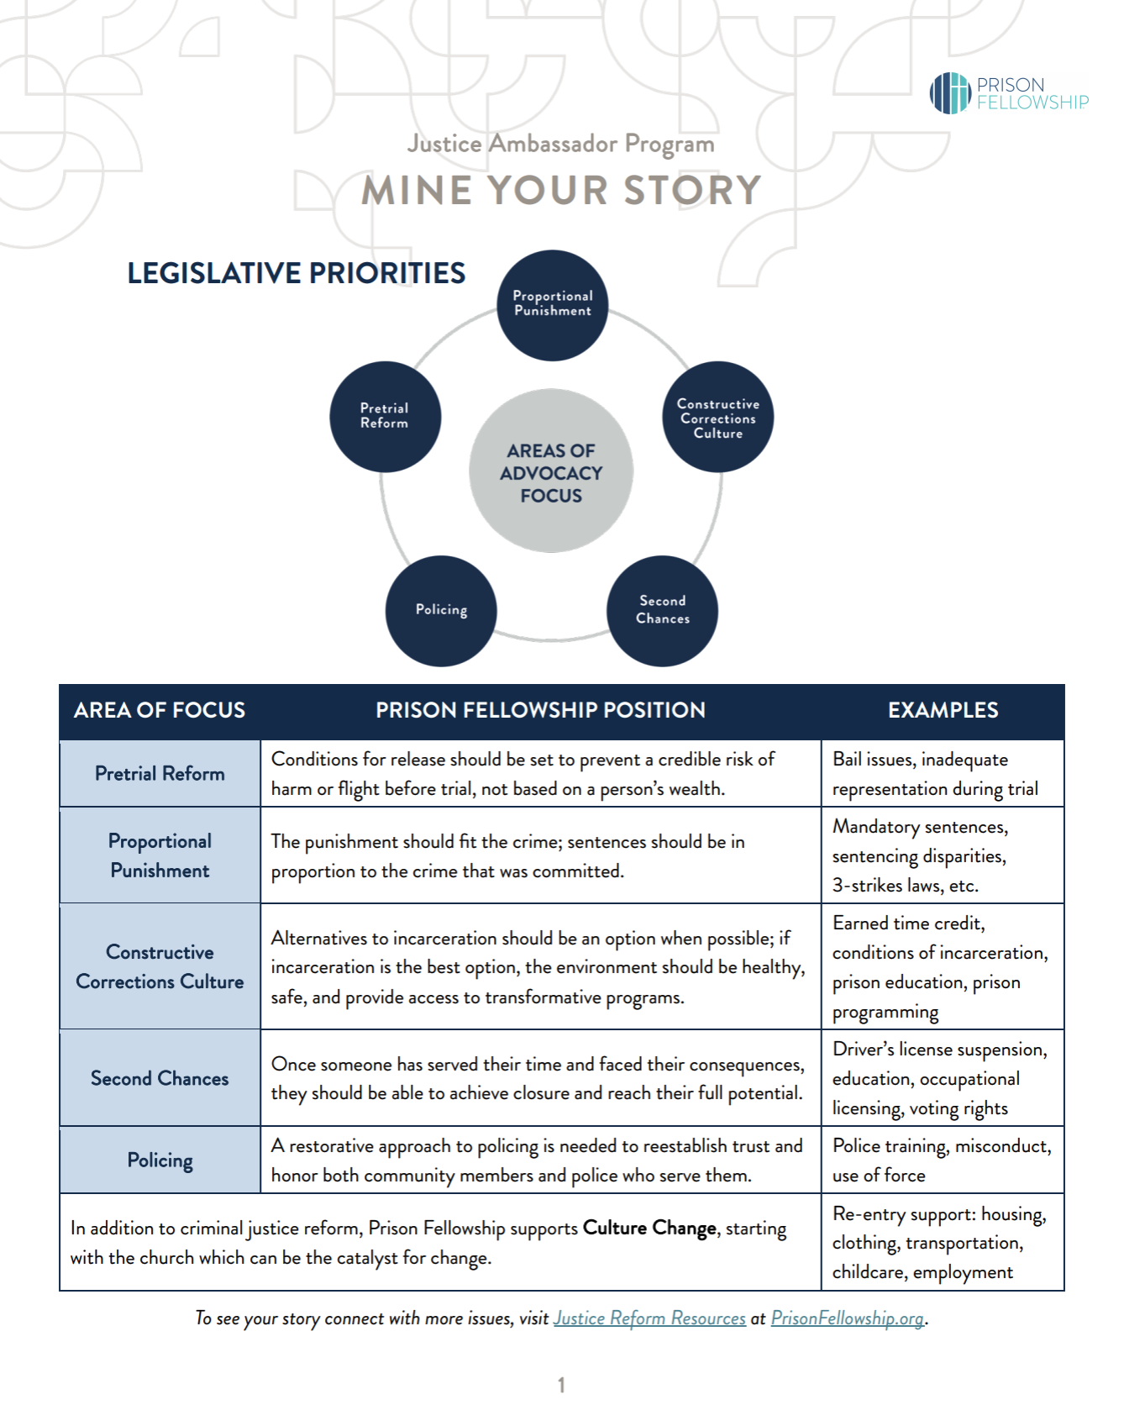
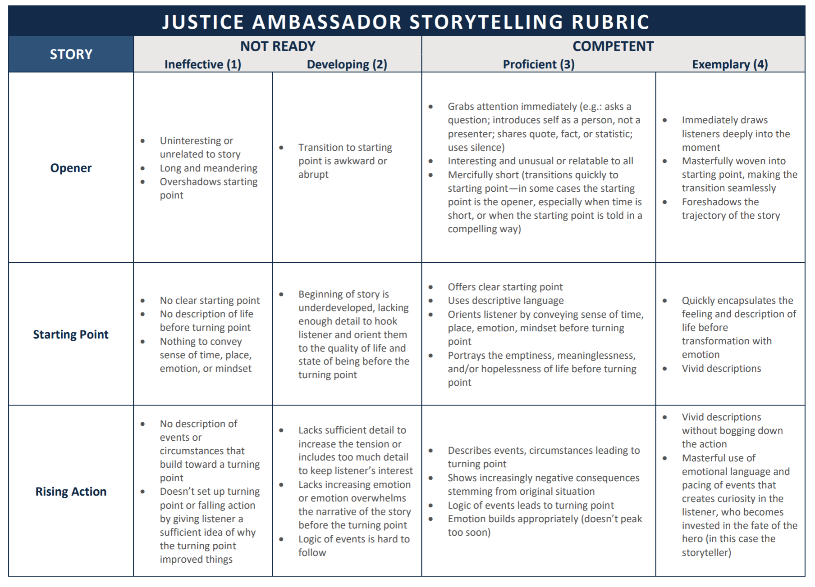
Tools

Slide 13
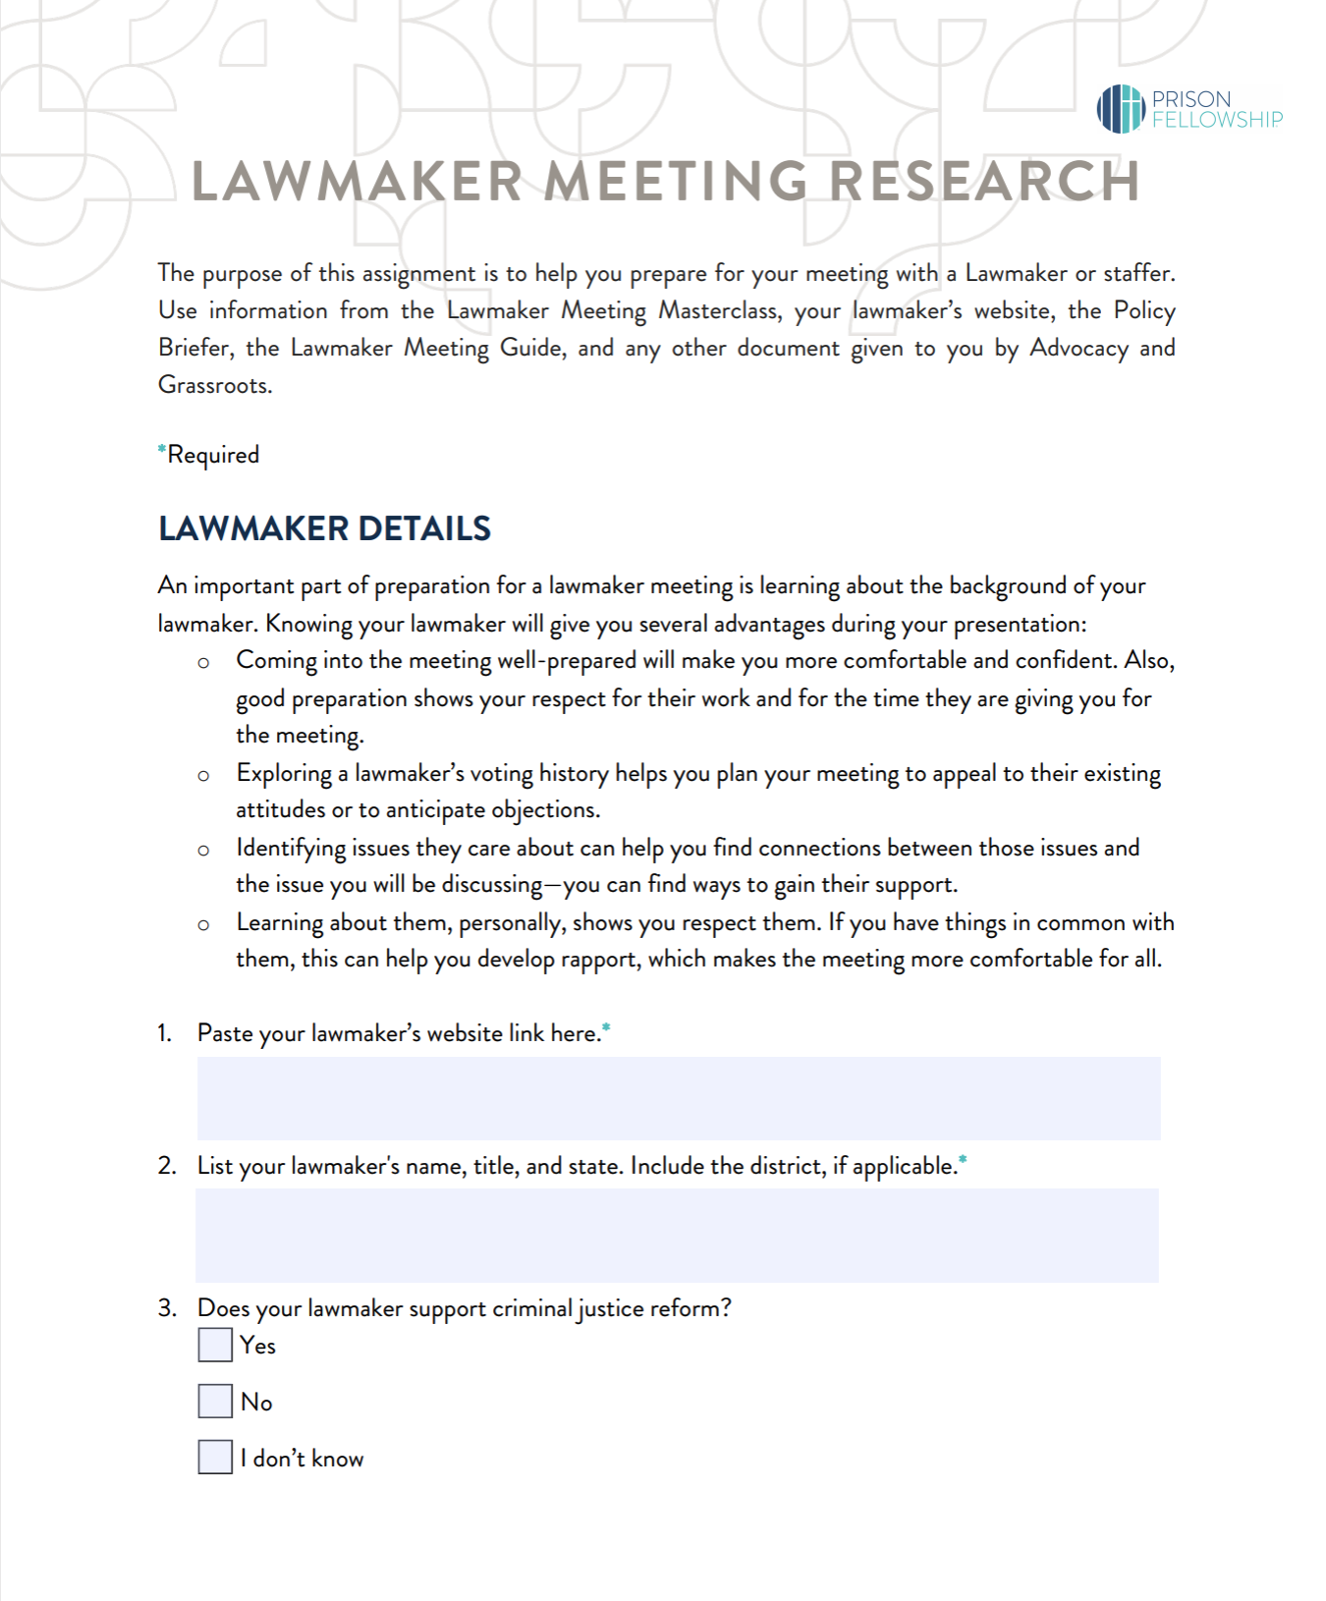
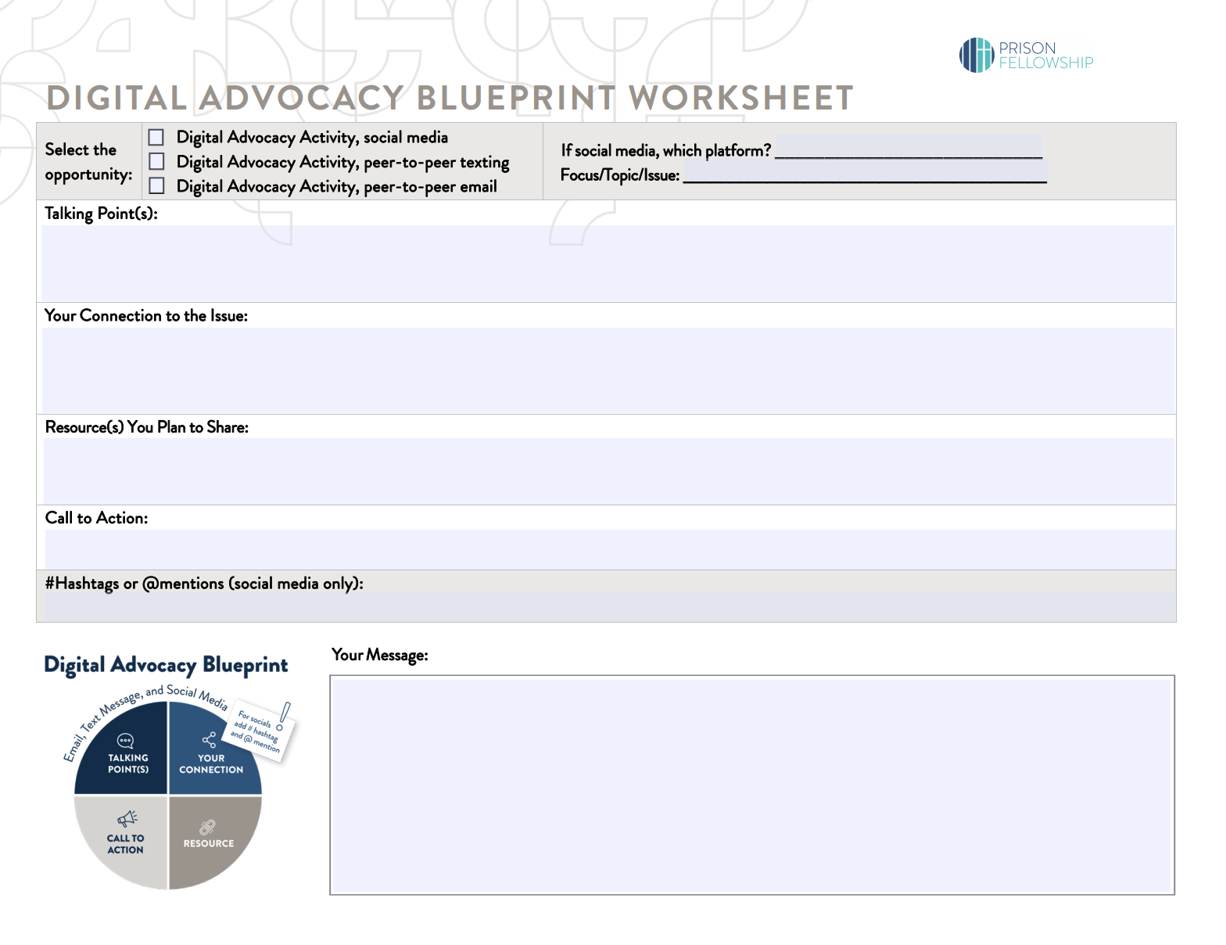
Tools

